Slide 1
Information Security
Week 02

Slide 2
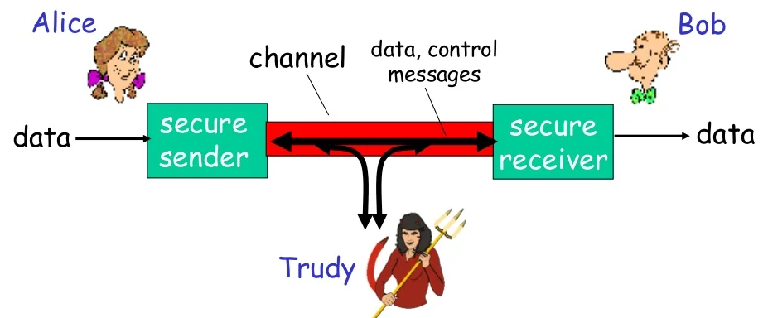

Slide 3
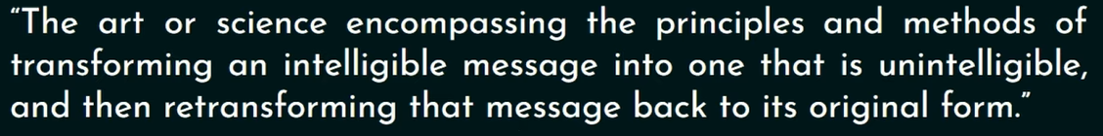
Cryptography
The universal technique for providing confidentiality for transmitted or stored data is encryption.

Slide 4

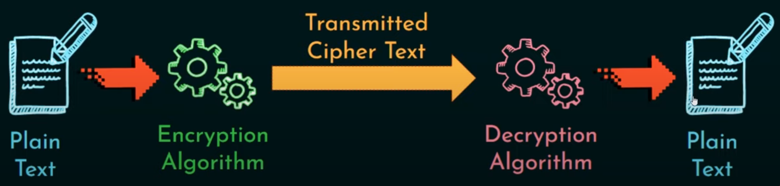

Slide 5
Types
Symmetric Cryptography
Asymmetric Cryptography

Slide 7
Encryption Schemes
Unconditionally Secure
Computationally Secure

Slide 8
Symmetric encryption
Symmetric encryption, also referred to as conventional encryption or single-key encryption.
The key used to encrypt and decrypt a plain text is same.

Slide 9
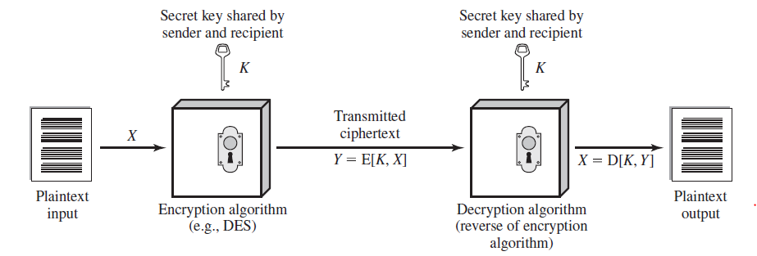

Slide 10
Symmetric encryption
Plaintext: This is the original message or data that is fed into the algorithm as input.
Encryption algorithm: The encryption algorithm performs various substitutions and transformations on the plaintext.
Secret key: The secret key is also input to the encryption algorithm. The exact substitutions and transformations performed by the algorithm depend on the key.
Ciphertext: This is the scrambled message produced as output. It depends on the plaintext and the secret key. For a given message, two different keys will produce two different ciphertexts.
Decryption algorithm: This is essentially the encryption algorithm run in reverse. It takes the ciphertext and the secret key and produces the original plaintext.

Slide 11
two requirements for secure use of symmetric encryption
We need a strong encryption algorithm: we would like the algorithm to be such that an opponent who knows the algorithm and has access to one or more ciphertexts would be unable to decipher the ciphertext or figure out the key.
Secure Key Mechanism: The sender and receiver must have obtained copies of the secret key in a secure fashion and must keep the key secure.

Slide 12
attacking a symmetric encryption scheme
Cryptanalysis attack: Exploits the characteristics of the algorithm.
Brute-force attack: Try every possible key on a piece of ciphertext until an intelligible

Slide 13
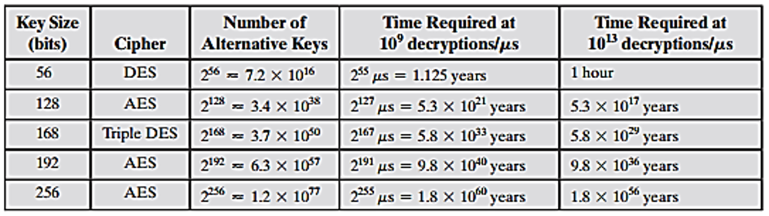
Average Time Required for Exhaustive Key Search

Slide 14
DES
DES stands for Data Encryption Standard.
The DES algorithm uses a key of 56-bit size. Using this key, the DES takes a block of 64-bit plain text as input and generates a block of 64-bit cipher text.
Depending upon the size of the key being used, the number of rounds varies. For example, a 128-bit key requires 10 rounds, a 192-bit key requires 12 rounds, and so on.

Slide 15
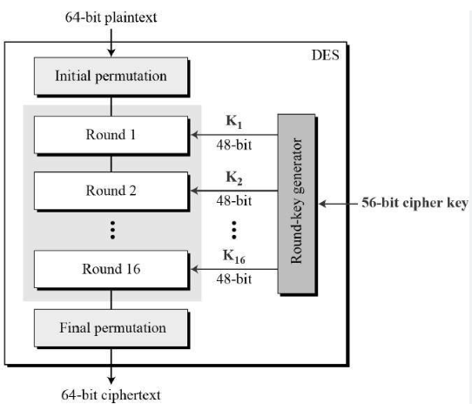

Slide 16
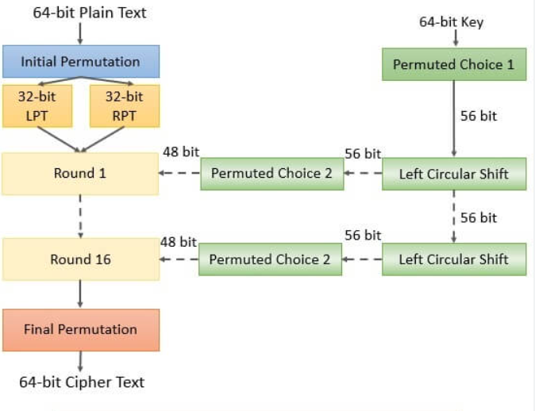

Slide 17
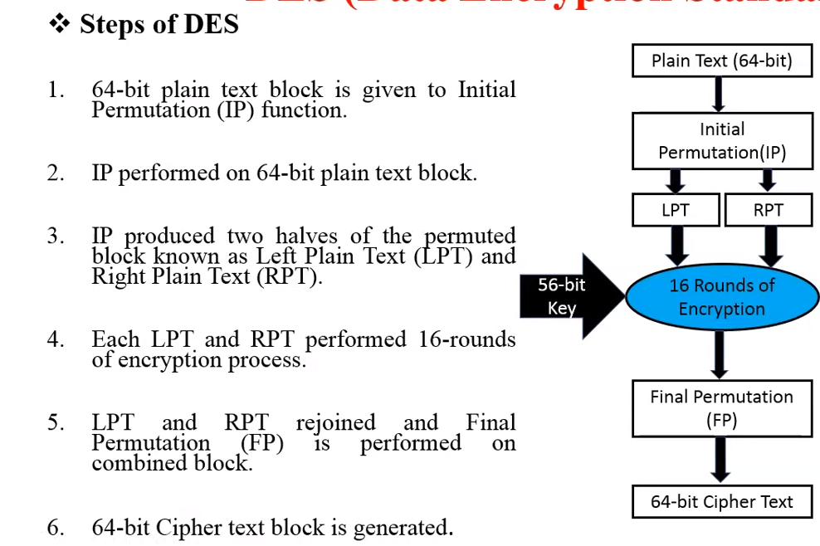
Steps of DES

Slide 18
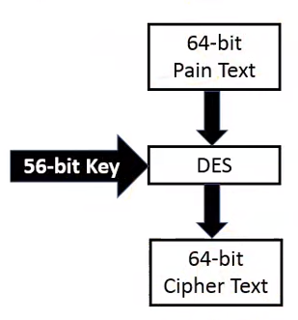
DES Process

Slide 19
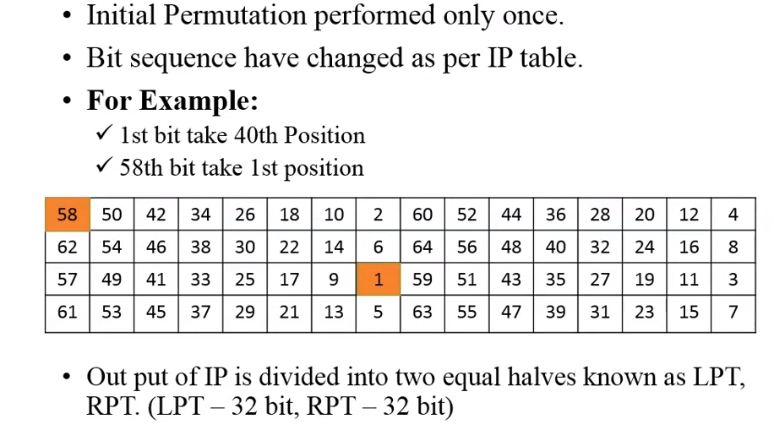
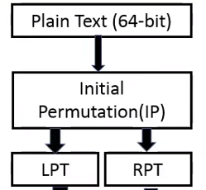
Initial Permutation

Slide 20
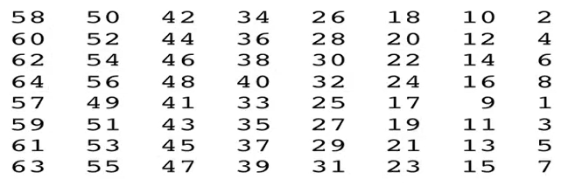
IP Table

Slide 21
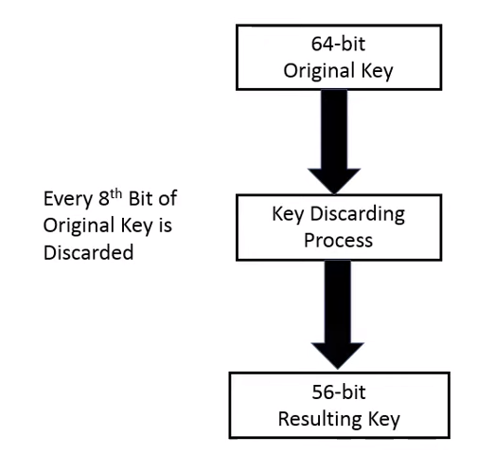
Key Discarding Process

Slide 22
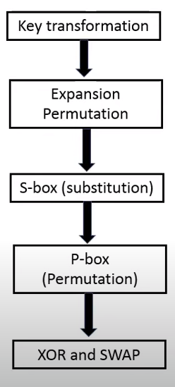
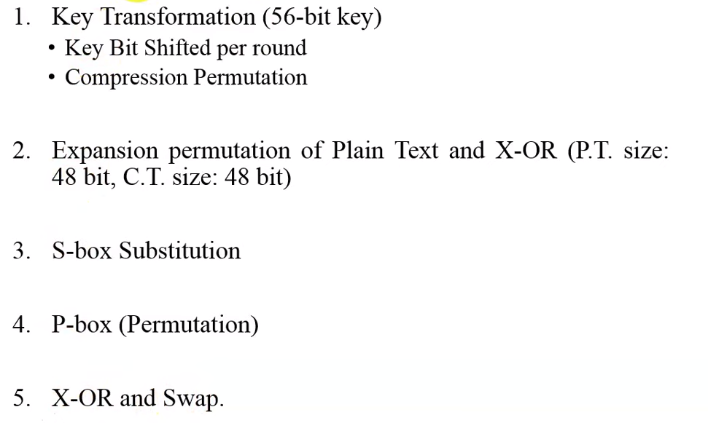
Key Transformation

Slide 23
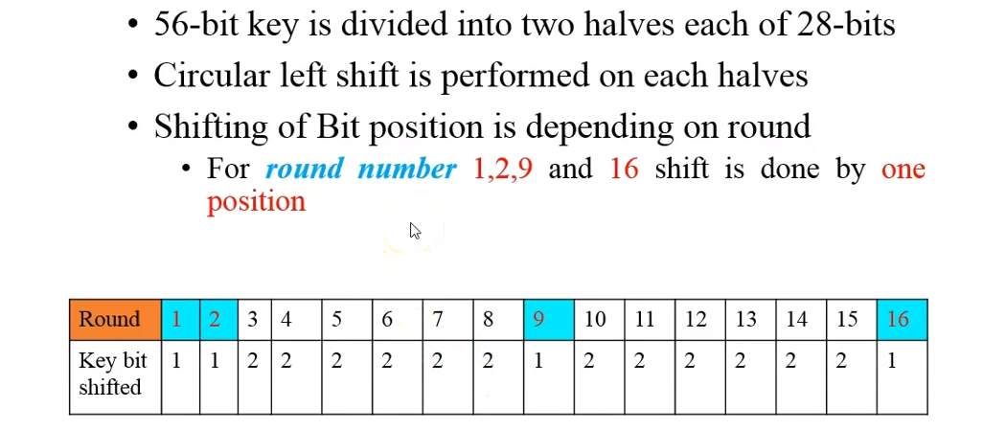
Key Bit shifting process

Slide 24
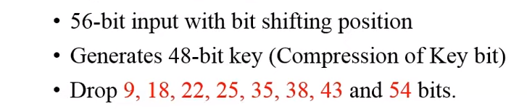
Compression Permutation (PC)

Slide 25
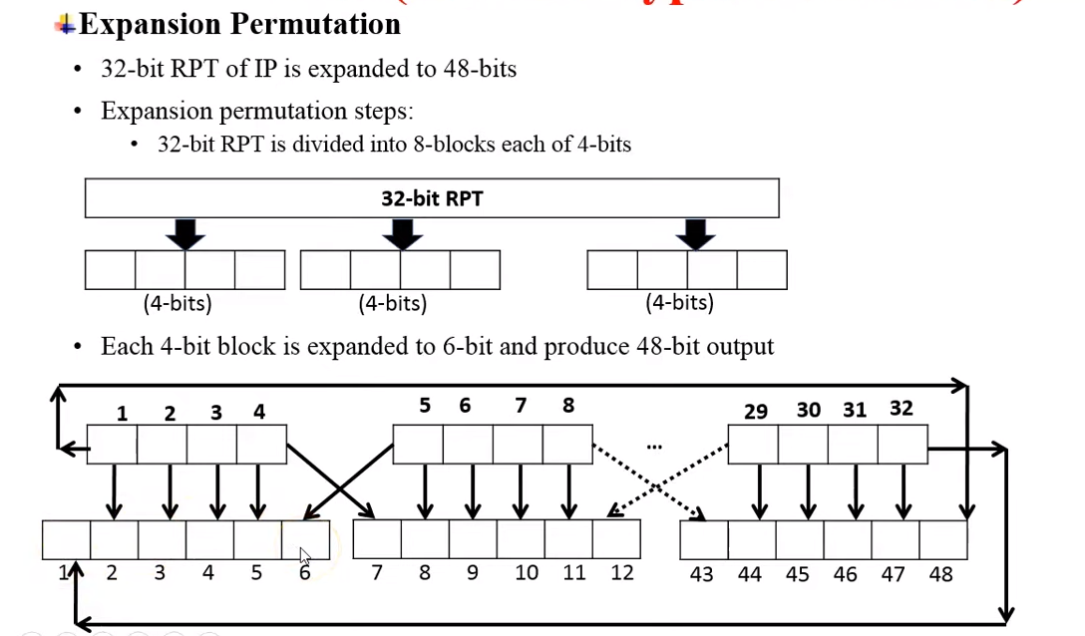
Expansion Permutation

Slide 26
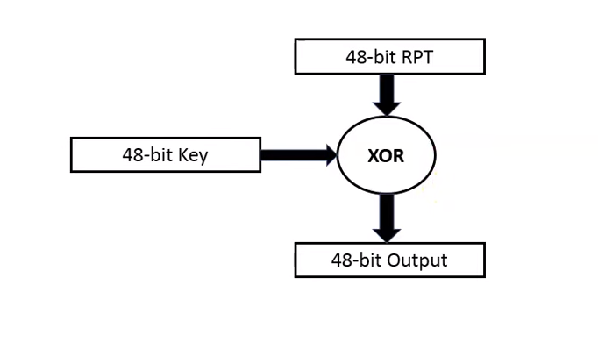

Slide 27
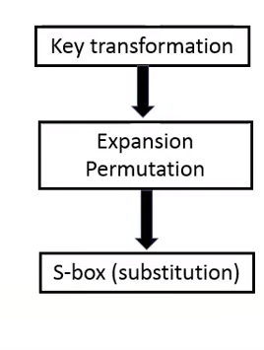

Slide 28
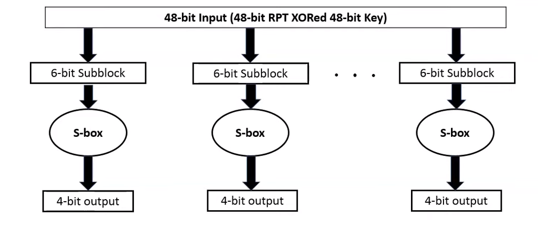
S-Box Substitution

Slide 29
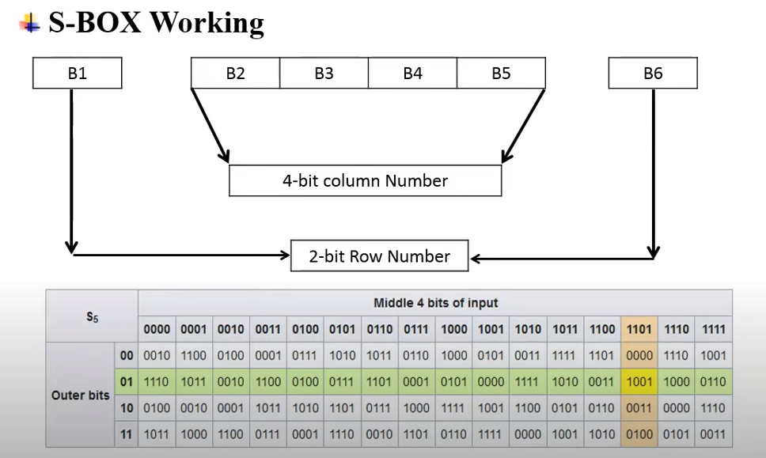
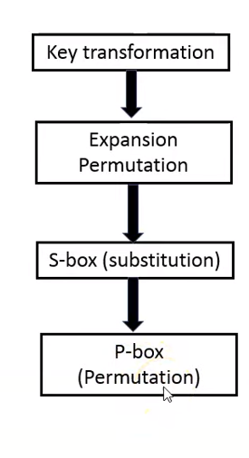
S-Box Working

Slide 30
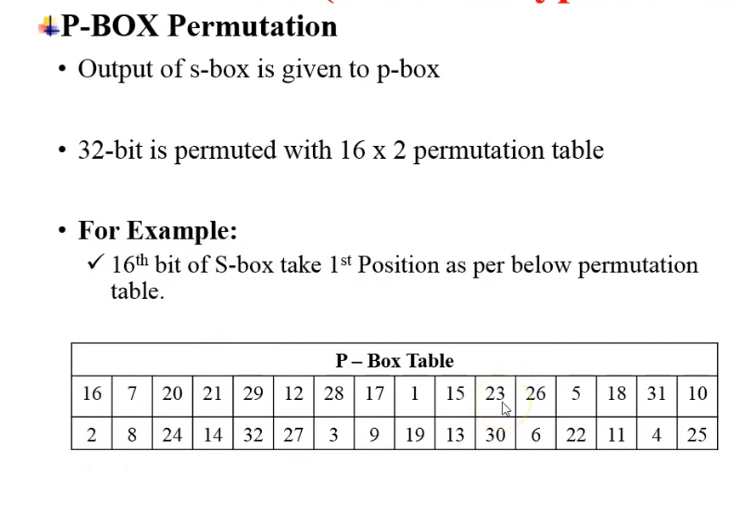
P-Box permutation

Slide 31
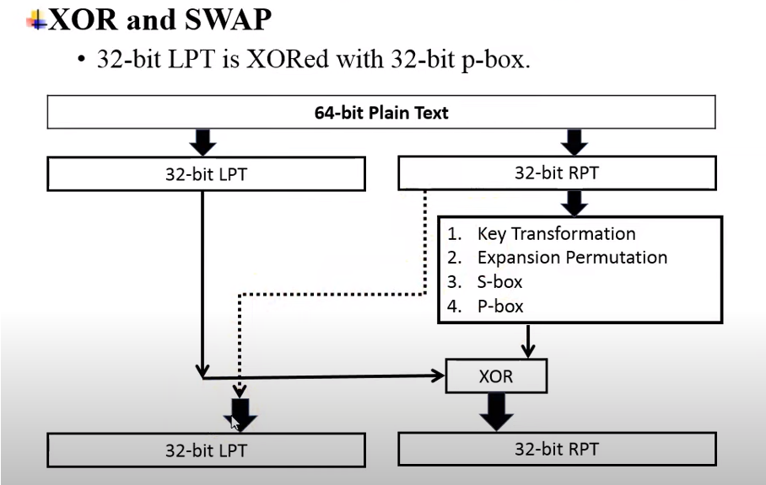
Xor and swap

Slide 32
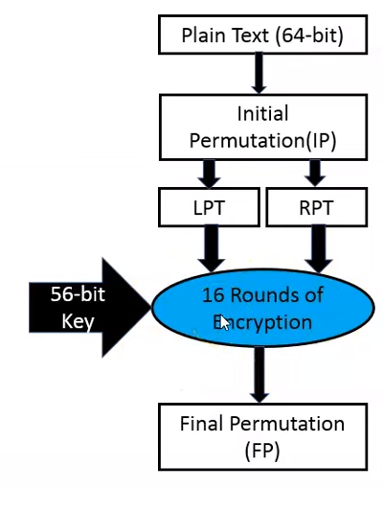

Slide 33
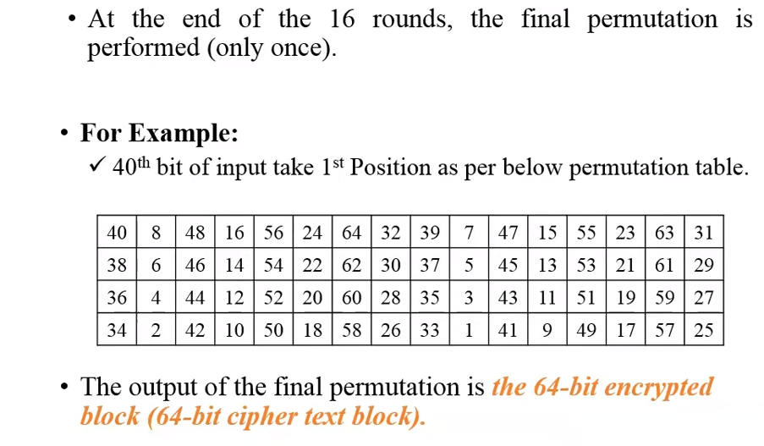

Slide 34
Video Link
https://www.youtube.com/watch?v=3YBwhWuXZ0o

Slide 35
Document Link
https://page.math.tu-berlin.de/~kant/teaching/hess/krypto-ws2006/des.htm

